Slide 1



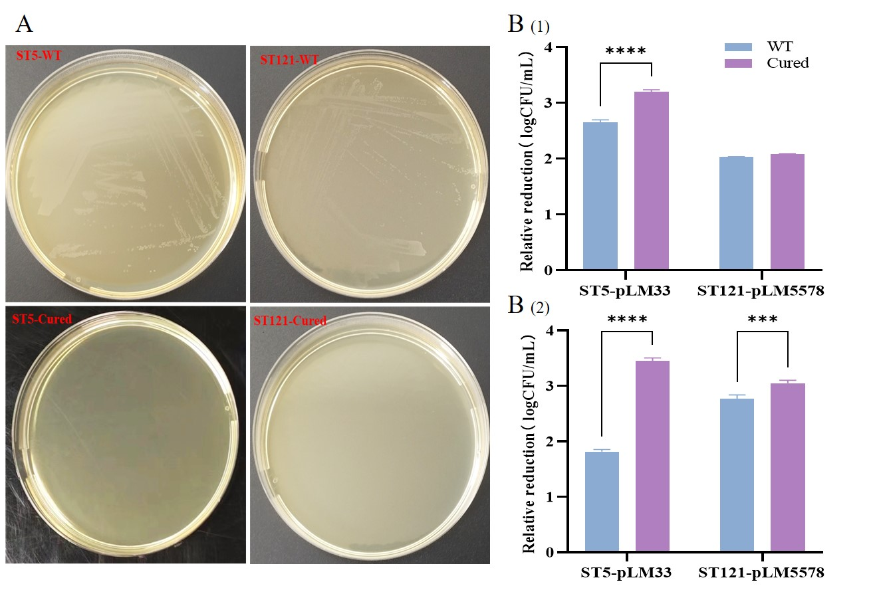
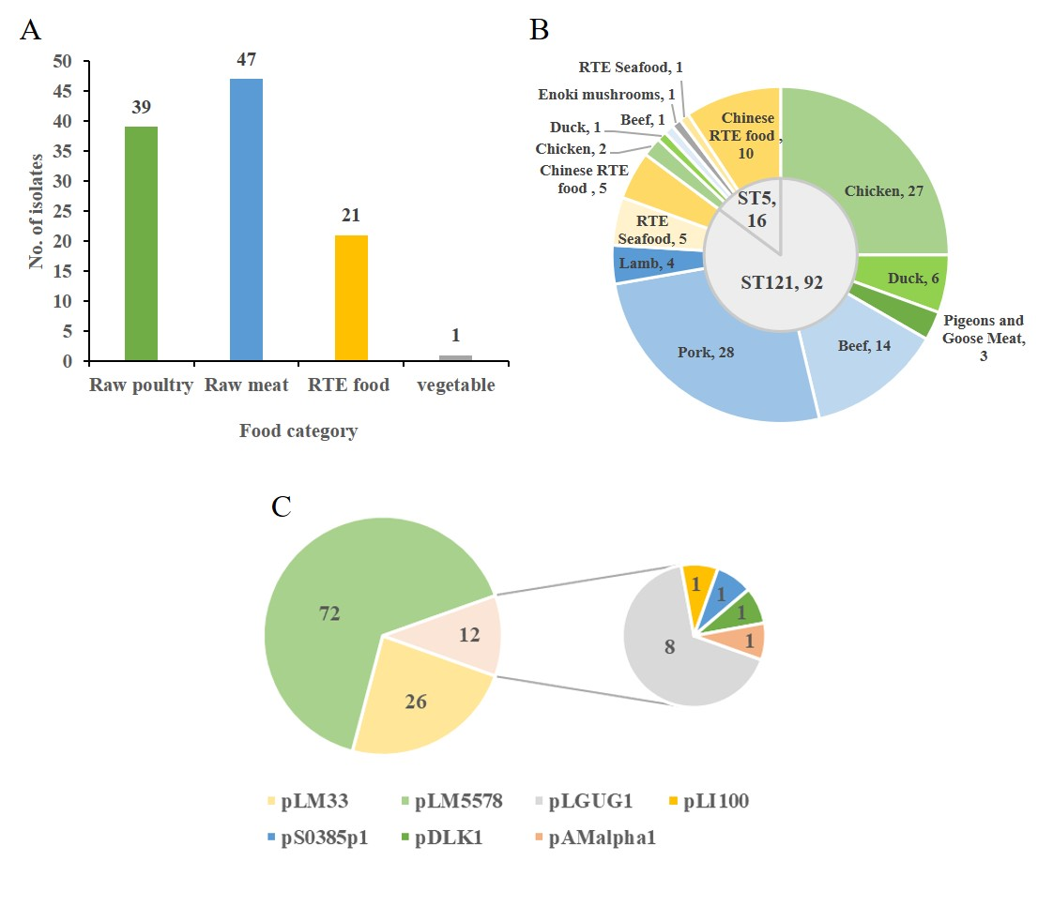
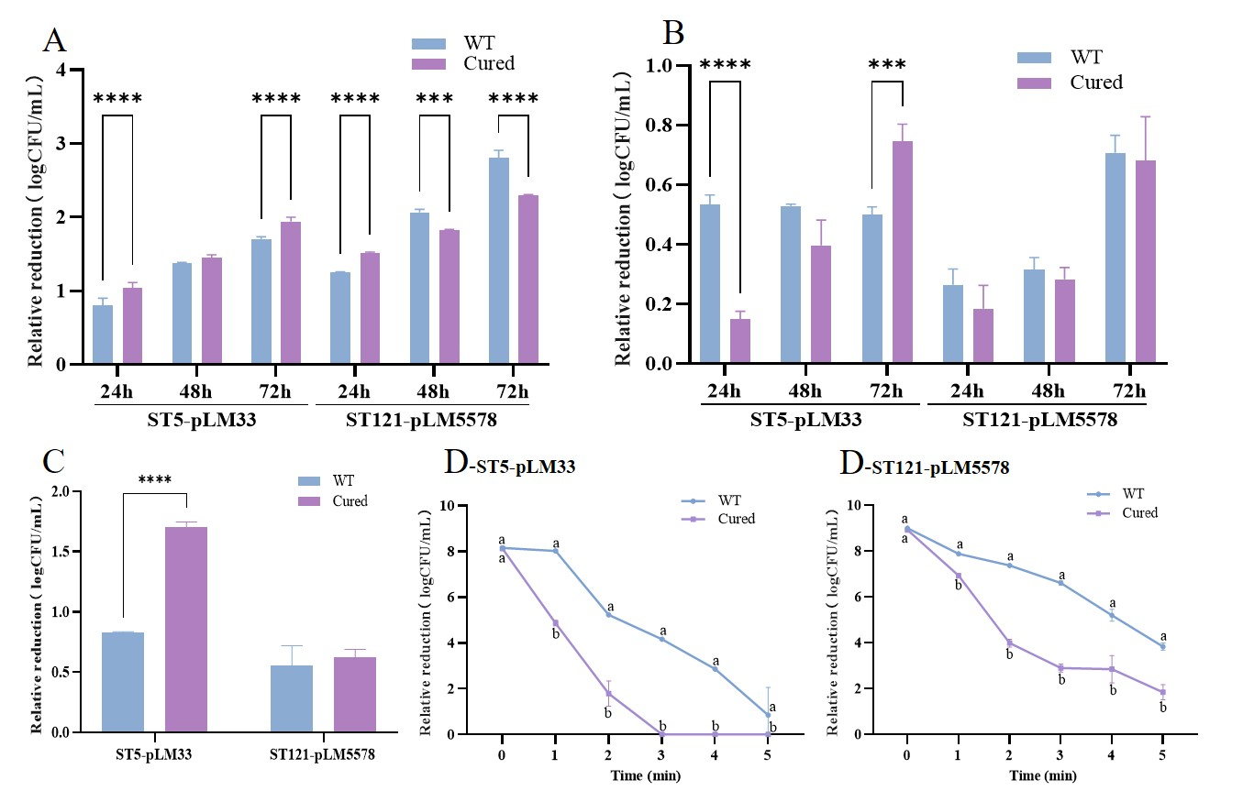
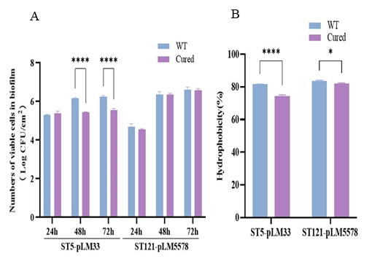
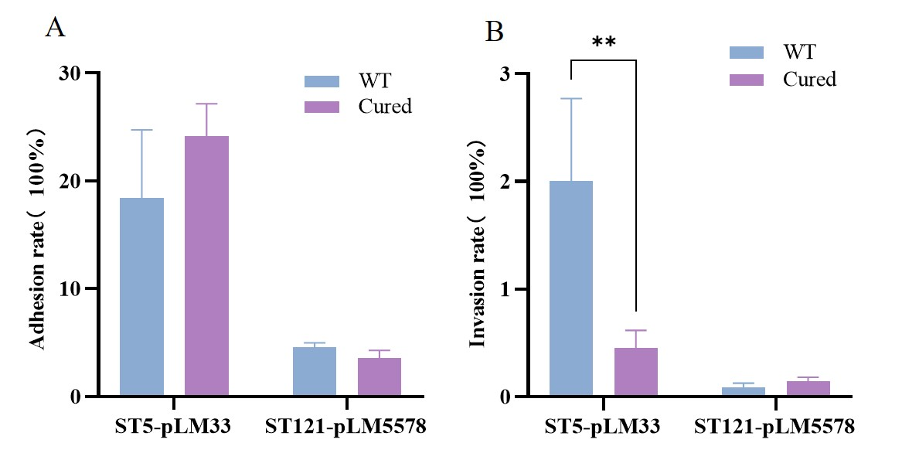
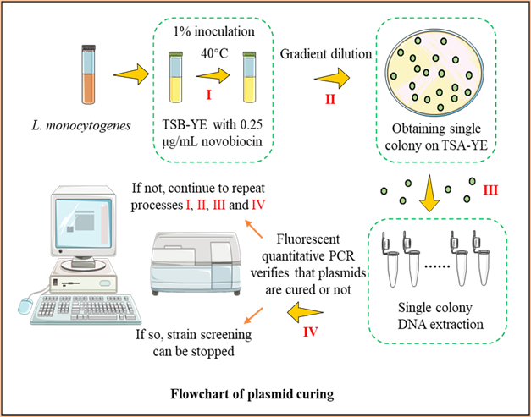
FSMILE 2025
p L M 3 3 p r o v i d e s t o l e r a n c e o f p e r s i s t e n t L i s t e r i a m o n o c y t o g e n e s S T 5 t o v a r i o u s s t r e s s c o n d i t i o n s a n d a l s o e n h a n c e s i t s v i r u l e n c e
October 04-07, 2025
@Morioka & ZOOM Cloud
International Symposium on Food Communications and Sustainable Agri-Aqua Food Systems
Connecting Primary Industries, Academia, and Society through the SDGs
X. Liu1, T-Q. Shi2, J-M. Li1, H-Y. Wu2, Q. Zhao1, Z-X. Fang2, Y-Y. Liang2, Q. Xiao2, M. Chen2, Q-L. Dong1#, H-Z. Zhang2#
1 University of Shanghai for Science and Technology, Shanghai, China
2 Shanghai Municipal Center for Disease Control and Prevention, Shanghai, China
Contact Information:
Qingli Dong: qdong@usst.edu.cn
Hongzhi Zhang: zhanghongzhi@scdc.sh.cn
Introduction
Listeria monocytogenes is a major foodborne pathogen. In our previous study [1], we found that L. monocytogenes ST5 and ST121 strains were dominant in two food plants of Shanghai. And compared with transient strains isolated from the same plant without carrying any plasmids, their biofilm formation and disinfectant tolerance are stronger [2]. Therefore, we propose a hypothesis that the tolerance of these strains may be related to the plasmids they carry.
Results
AIM
Investigation on the types and rates of plasmids carried in food isolates of L. monocytogenes in Shanghai area.
Clarify the function of plasmids of L. monocytogenes in the stress survival mechanism of food and FPEs.
Analyzing the genetic information of plasmids carried by L. monocytogenes.
Fig. 2. Tolerance of wild-type (WT) and plasmid-cured Listeria monocytogenes to the heavy metal cadmium and common disinfectants, displayed as a log decrease based on CFU/mL. A) Images of all strains incubated on the TSA-YE plate with 130 μg/mL cadmium sulfate for 3 d; B) (1) 100 μg/mL benzalkonium chloride for 5 min, (2) 100 μg/mL chlorine-containing disinfectant for 3 min.
Fig. 5. Food sources and number of 108 Listeria monocytogenes strains evaluated in this study. A: Four food categories of 108 L. monocytogenes strains. B: Distribution of different food categories in the two ST types (ST5 and ST121). C: Plasmid carrying type and quantity of 105 strains of L. monocytogenes.
Fig. 1. Tolerance of wild-type (WT) and plasmid-cured Listeria monocytogenes under different environmental stress conditions, displayed as log decrease based on CFU/mL. Error bar represents standard deviation between three duplicate datasets. The stress conditions are: A) pH 3; B) 30% NaCl; C) 0.3% H2O2; and D) 60◦C.
Table 1. Plasmid information carried by the wild-type strain of Listeria monocytogenes used in this study.
Method
Strain | Plasmid | Plasmid size(bp) | BLASTn with Reference plasmids |  | Antibiotic Resistance | Metal & Disinfectants Resistance | Stress Islands
 |  |  | nucleotide identity/query coverage | Genbank
19052（ST5） | pLM33 | 48,429 | 98.29% / 80% | CP099458.1 | ermG | cadA | SSI1_lmo0445 (lmo0445)
2061(ST121) | pLM5578 | 60,922 | 99.16% / 80% | CP001603.1 | - | cadA | SSI1_lmo0445 (lmo0445)
Fig. 3. Biofilm(A) and hydrophobicity(B) testing of wild-type (WT) and plasmid-cured Listeria monocytogenes.
Fig. 4. Virulence test of wild-type (WT) and plasmid-cured Listeria monocytogenes strains in Caco-2 cells. A) adhesion rate; B) invasion rate.
Conclusions
Plasmids were commonly carried in food isolates in Shanghai, with a plasmid carrying rate of 97.22% (105/108).
The presence of plasmids enhanced the survival of Listeria monocytogenes in various unfavorable environmental conditions.
pLM33 enhanced the virulence of persistent Listeria monocytogenes ST5.
References
[1] Zhang H-Z et al. Listeria monocytogenes Contamination Characteristics in Two Ready-to-Eat Meat Plants From 2019 to 2020 in Shanghai. Front Microbiol. 2021;12:729114.
[2] Liu X et al. Persistence of Listeria monocytogenes ST5 in Ready-to-Eat Food Processing Environment. Foods. 2022;11(17):2561.

